Slide 1
JOBFINDER: A PERSONALIZED RÉSUMÉ – JOB MATCHING SYSTEM
MS Thesis Presentation of:
Shiquang Guo
Sketch Recognition Lab
Department of Computer Science, TAMU
Dr. Tracy Hammond (Advisor)
Dr. Yoonsuck Choi (Member)
Dr. Daniel Goldberg (Member)

Slide 2





Motivation
Job finding websites are one of main channels today
There are many job finding websites today.

Slide 3


They all use keyword Searching

Slide 4
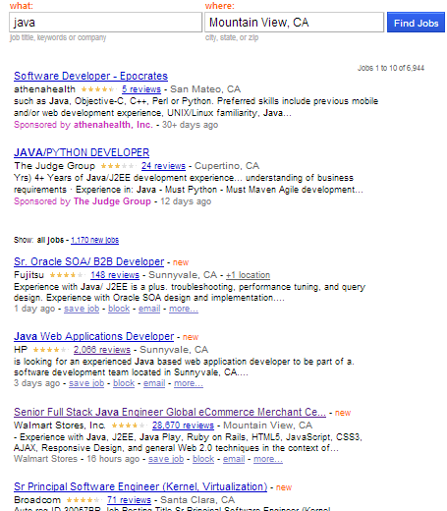
Problems of keyword Searching
When searching with keyword “Java”
7000 jobs returned.
Too many jobs return
The result is not well ranked
Job finding become a tedious work

Slide 5
Motivation
The résumé has the most personal information
Education Background
Work experiences
Skills
Using the résumé as a query to search jobs
Ranking the jobs by their similarity scores

Slide 6
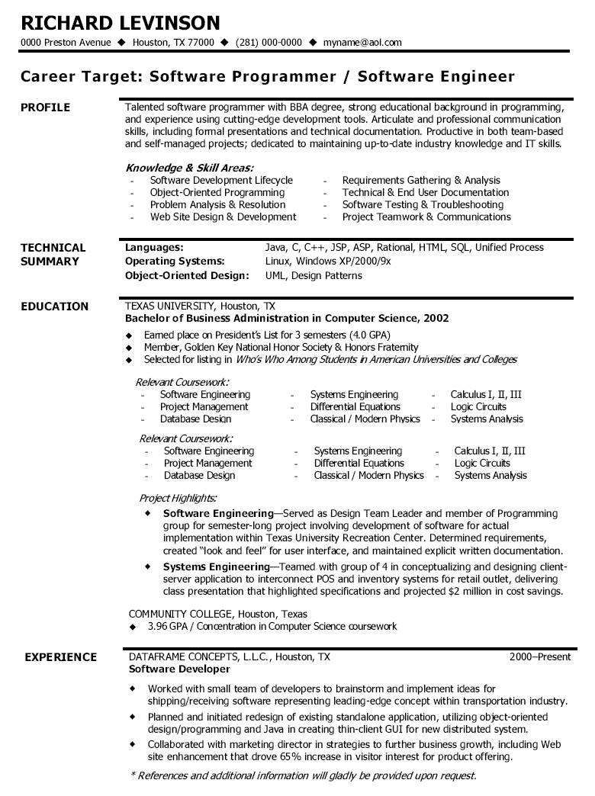
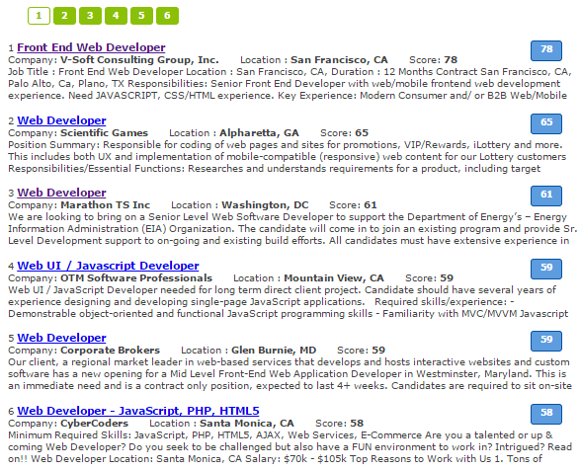
Job Finder

Slide 7
Contributions of our works
A résumé – job matching system
Propose a finite state transducer based tool for information extraction
Propose a semi-automatic approach to collect technical terms
Propose a statistical-based ontology similarity measure
A new searching approach which combines keyword searching and model matching

Slide 8
Previous Work

Slide 9
Previous work – Recommender Systems
Content-based Recommendation (CBR)
Collaborative Filtering Recommendation (CFR).
Knowledge-based Recommendation (KBR)
Hybrid Recommendation
Notes:
Hybrid Recommendation : combines multiple recommendation techniques together to produce its output.

Slide 10
Previous work – CASPER
CASPER (Rafter et. al. 2000)
Collaborative Filtering based Job Recommender System
Get User’s profile from server-log:
Jobs visited
Read time
Jobs Applied

Slide 11
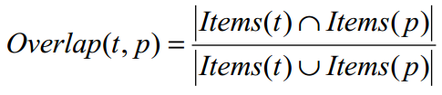

Previous work – CASPER
Shortcomings of Collaborative Filtering
Cold start
Sparseness of users’ profiles

Slide 12
Previous work – Hybrid Recommender System
Yao Lu et. al. 2013
Content – based Recommendation
Similarity is computed using Latent Semantic Analysis (LSA)
Collaborative Filtering Recommendation

Slide 13
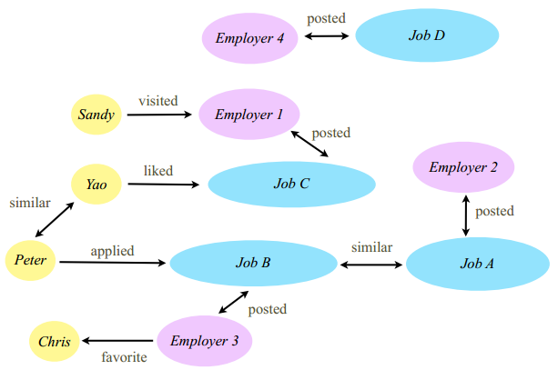
Previous work – Hybrid Recommender System

Slide 14
Previous work – Hybrid Recommender System
Recommend Job C to Peter because Yao liked Job C, and Peter and Yao have similar profiles;
Recommend Job A to Peter because Peter applied for Job B, and Job A and Job B are similar;
Recommend Employer 3 to Peter because Peter applied for Job B and Job B is posted by Employer 3;

Slide 15
Previous work – IBM PROSPECT
A system that aids in the shortlisting of candidates for jobs.
Using Conditional Random Fields (CRFs) model to extract the information from résumés
Filtering the candidates with criterias

Slide 16
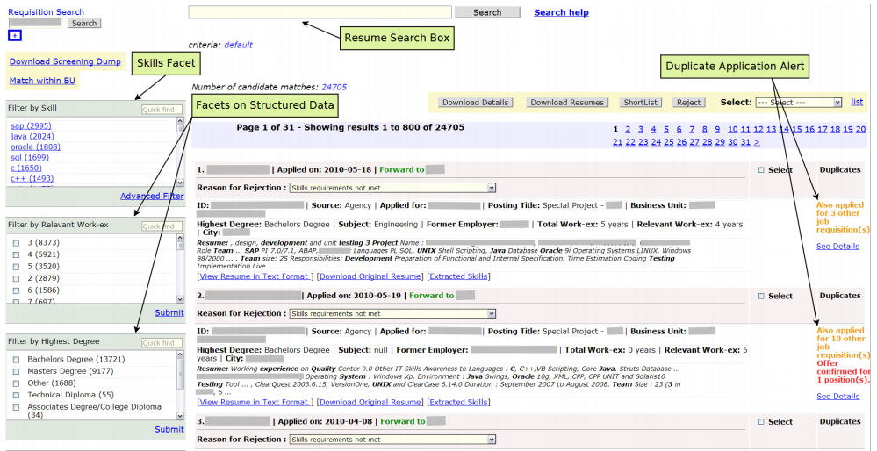
Previous work – PROSPECT

Slide 17
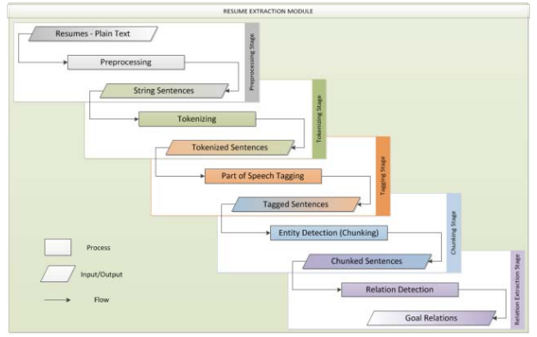
Previous work – HP Resource Planning Tool
Staged Information Extraction Framework
Help managers to find
right candidates

Slide 18
Previous work – Problems
Most systems can only process the structured data or synthetic data
The systems that have information extraction module are designed for recruiters
Information fields for matching résumés and job descriptions are coarse-grained.

Slide 19
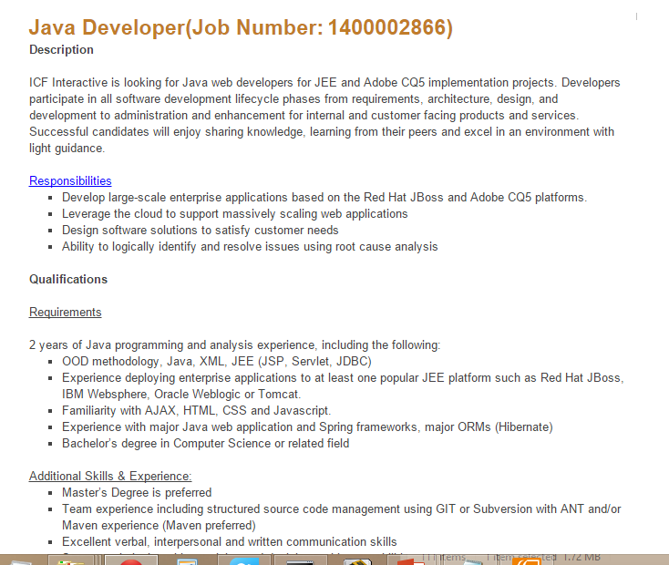
Problem Definition

Slide 20
Problem Definition
Calculating the similarity values between the user’s résumé and the job models
Return the jobs ranked by their similarity values

Slide 21
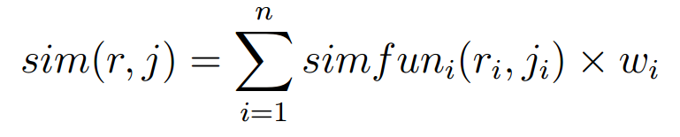
Problem Definition
r is the user‘s résumé model
r_{i} is the ith feature of résumé r
j is the job description model
j_{i} is the ith feature of job j
Similarity value is the summation of weighted similarity values of each field in the models

Slide 22
Problem Definition
J is the set of jobs in the system
Searching jobs with a résumé → search(r, J)
Return a list of jobs that ranked by their similarity values sim(r, j ).

Slide 23
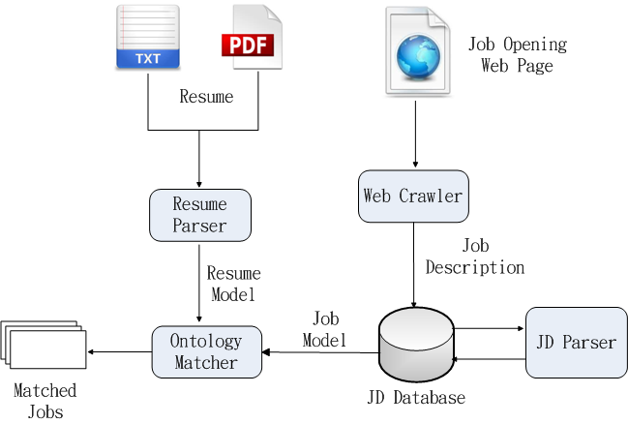
System Architecture

Slide 24
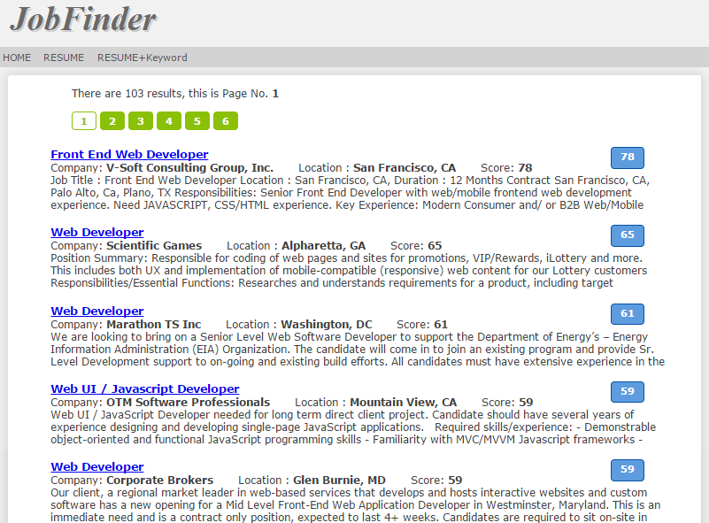
System Interface

Slide 25
Information Extraction

Slide 26
Extracting the models
Users don’t like input their personal information
Recruiters don’t like to input job descriptions in forms
So we need extract information from the unstructured text data source.

Slide 27
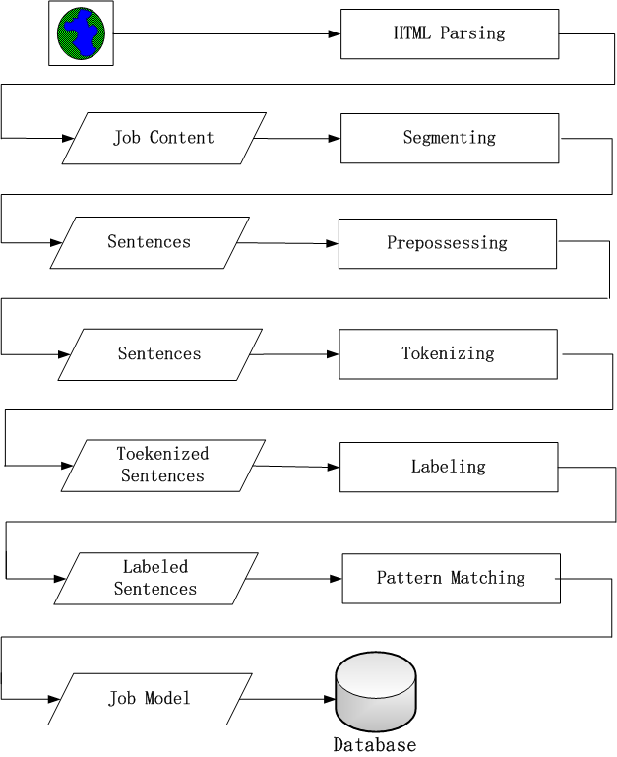
Information Extraction Stages
HTML Parsing
Segmenting
Preprocessing
Tokenizing
Labeling
Pattern Matching
Notes:
Acronym

Slide 28
Library for Regular Expression Over Tokens
The unit of the regular expression is token or word
seqMatcher = parser.parse
( “ DE_LEVEL (, DE_LEVEL)* (or DE_LEVEL)? DEGREE”)

Slide 29
Regular Expression Over Tokens
Bachelors degree in Computer or Information Systems
BS or MS in computer science or similar degree
MS/PhD Degree in Computer, Science, Engineering or Finance from top institution.
Requires a minimum of bachelors degree in a related, field or foreign equivalent.

Slide 30
Combinatorial Explosion
A single concept may have multiple expressions
“bachelor’s degree”, the pattern will like below:
( Baccalaureate | bachelors | bachelor | B.S | BS | BA ) degree
All words mean bachelors:
Baccalaureate, bachelors, bachelor, B.S., BS, BA, BA/BS, 4-year, 4-year, 4 year, four year, college, Undergraduate , University

Slide 31
Semantic Labeling
Original text | Layer 1 | Layer 2
bachelors | BS_LEVEL | DE_LEVEL
bachelor
B.S.
Baccalaureate
Master | MS_LEVEL
MS
M.S.
PhD | PHD_LEVEL
Ph.D
doctorate
Notes:
Underline or undersore??

Slide 32
Semantic Labeling
Bachelors degree in computer science or information systems
To
DE_LEVEL | DEGREE | IN | MAJOR | OR | MAJOR | .
BS_LEVEL | DEGREE | IN | MAJOR_CS | OR | MAJOR_INFO | .
bachelors | degree | in | Computer Science | or | Information Systems | .

Slide 33
Pattern Matching
DE_LEVEL DEGREE IN MAJOR (OR MAJOR) ?
DE_LEVEL | DEGREE | IN | MAJOR | OR | MAJOR | .
BS_LEVEL | DEGREE | IN | MAJOR_CS | OR | MAJOR_INFO | .
bachelors | degree | in | Computer Science | or | Information Systems | .

Slide 34
Patterns Matching Degree
DE-LEVEL, DE-LEVEL, OR DE-LEVEL
DE-LEVEL DEGREE ( IN | OF ) DT MAJOR
MAJOR-DEGREE , MAJOR-DEGREE OR MAJOR
DE-LEVEL (, DE-LEVEL)* (OR DE-LEVEL)? BE? PERFER-VBD
MAJOR DEGREE
DE_LEVEL , OR DEGREE_JJ

Slide 35
Implementation of Regular Expression Over Tokens

Slide 36
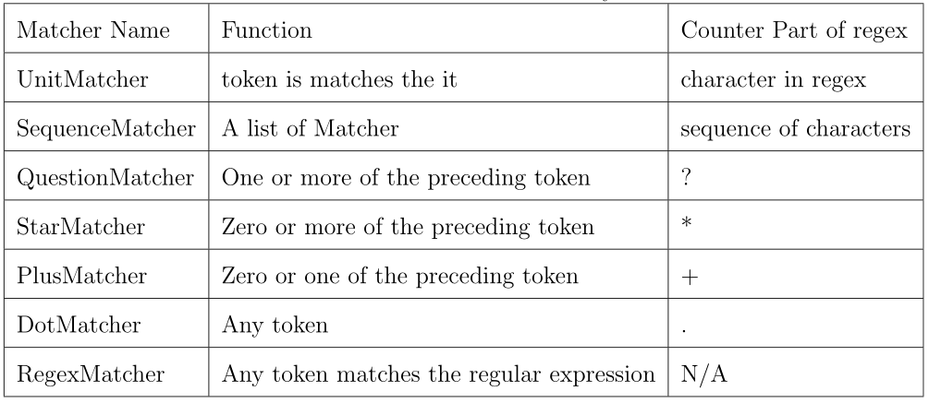
Matchers current support

Slide 37
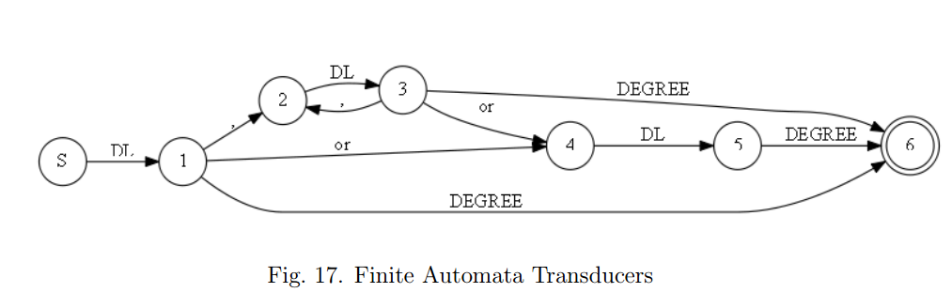
Finite Automata Transducers
A finite state transducer (FST) is a finite state machine with two tapes: an input tape and an output tape.

Slide 38
Flexibility – Lambda expression
lambda x:x[0] – catch the original text
lambda x:x[2] – catch the second layer label
lambda x:x[1] – output the first layer label

Slide 39
Flexibility – regular expression style
Pattern: DE-LEVEL DEGREE ( IN | OF ) DT? MAJOR
seqMatcher =parser.parse(”DE-LEVEL DEGREE ( IN | OF ) DT? MAJOR”)

Slide 40
Flexibility – connected by algebra operators
Pattern: ”DE-LEVEL DEGREE (IN | OF) MAJOR”
seqMatcher = UnitMatcher(”DE-LEVEL”) + UnitMatcher(”DEGREE”) + ( UnitMatcher(”IN”) | UnitMatcher(”OF” ) ) + UnitMatcher(”MAJOR”)

Slide 41
Flexibility – OO programming style
Pattern: ”DE-LEVEL DEGREE (IN | OF) MAJOR”
matcher1 = UnitMatcher(”DE-LEVEL”)
matcher2 = UnitMatcher(”DEGREE”)
matcher3 = UnitMatcher(”IN”)
matcher4 = UnitMatcher(”OF”)
matcher5 = UnitMatcher(”MAJOR”)
matcher6 = AlternateMatcher([matcher3,matcher4])
seqMatcher = SeqMatcher([matcher1, matcher2, matcher6, matcher5])

Slide 42
Simplicity
Easy to implement
The accuracy increases as the number of patterns increases
Faster: Time Complexity O(n)
Conditional Random Fields(CRFs), using Viterbi algorithm O(n²t)
Notes:
n state space, t length of the sequence

Slide 43
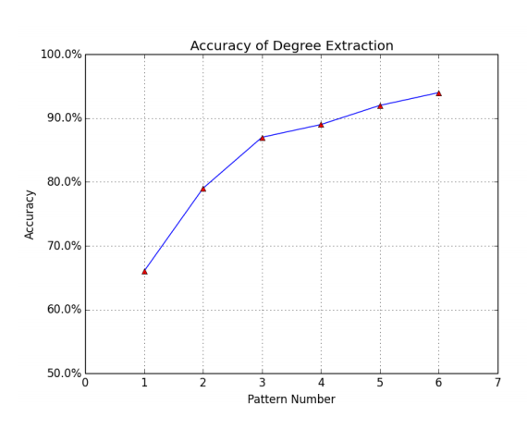
Simplicity

Slide 44
Similarity Construction and Calculation

Slide 45
Résumé and Job Description
Portion of a résumé | Portion of a job description
B.S. degree in computer science 5+ years Java 2+ year C++ Some experience in Oracle database Other experience like: Hibernate, JBOSS, JUnit, Tomcat etc. | BS degree above 4+ years Java Some experience of Python Mysql, MS-SQL Java web application Server OOA/OOD

Slide 46
How to Find terms in Job Descriptions
A high-level language such as Java, Groovy, Ruby or Python; we use Java and Groovy extensively
HTML5/CSS3/JavaScript, web standards, jQuery or frameworks like AngularJS would be great
HTML CSS and Javascript a must 4. Experience with AJAX, XML, XSL, XSLT, CSS, JavaScript, JQuery, HTML and Web Services

Slide 47
Bootstrap approach
< term , * , *, term > , < term , * , *, and term >
Bootstrap approach
Collecting fifty initial terms manually, and adding them to term list
Using the pattern matching library to find new terms
Checking the found terms on Dbpedia
under the technical categories like software, programming language and so on.
Adding the new terms in to term list

Slide 48
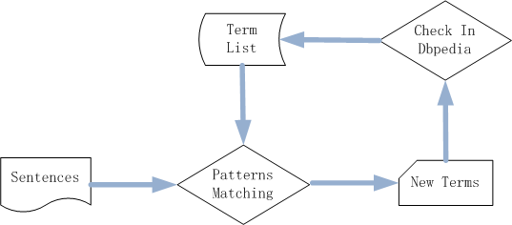
Bootstrap approach

Slide 49

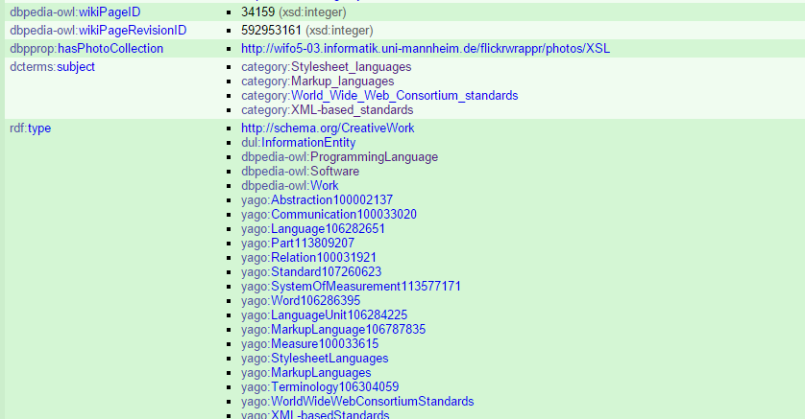
Dbpedia Page

Slide 50
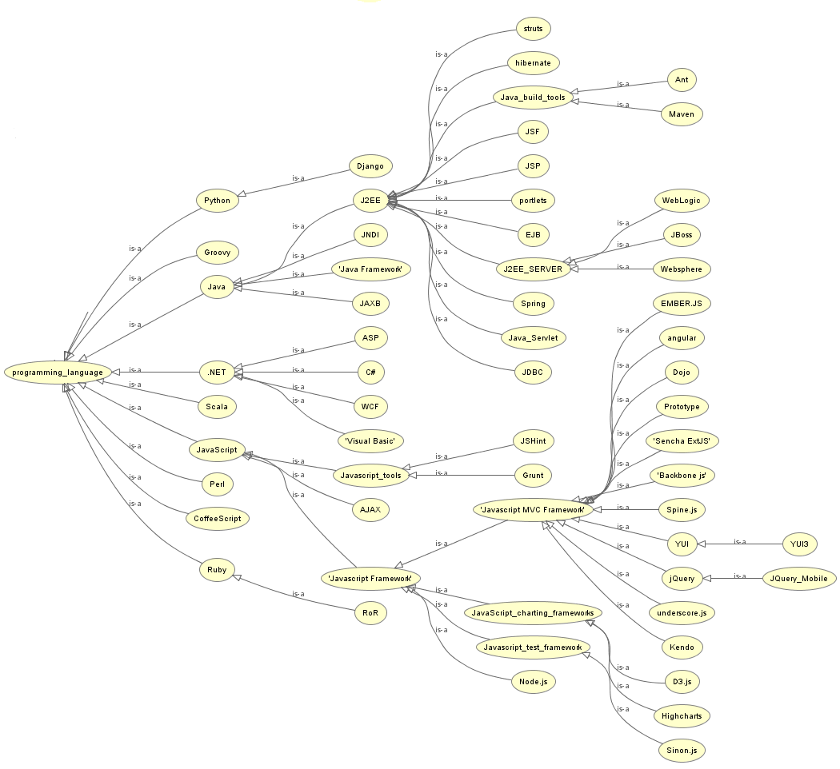

Slide 51
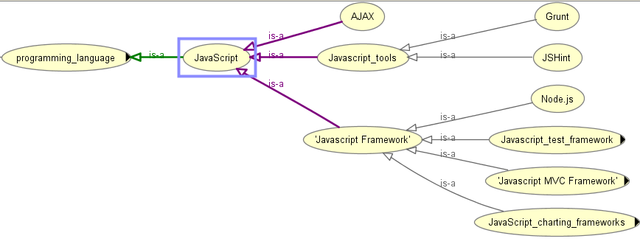
Ontology

Slide 52

Ontology similarity
Path-based approaches
They assume that all links in the ontology have uniform distance

Slide 53
Ontology similarity
Feature-based measures
Only big ontologies like Wordnet have this kind of information

Slide 54

Ontology similarity
Content-based measures
LCS -- is the Least Common Subsumer
IC -- IC is Information Content
The concepts must enough common subsumers.
Notes:
IC negative logarithmic value of its probability of occurrence

Slide 55
Statistical-based Ontology Similarity Measure
A high-level language such as Java, Groovy, Ruby or Python; we use Java and Groovy extensively
HTML5/CSS3/JavaScript, web standards, jQuery or frameworks like AngularJS would be great
HTML CSS and Javascript a must 4. Experience with AJAX, XML, XSL, XSLT, CSS, JavaScript, JQuery, HTML and Web Services

Slide 56
Statistical-based Ontology Similarity Measure
Related skills always exist in the job description simultaneously.
The smaller the distance of two skills, the closer the relationship between them.

Slide 57
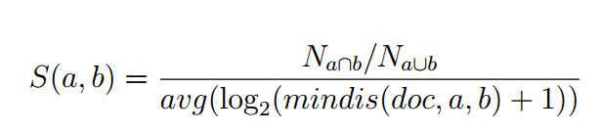
Statistical-based Ontology Similarity Measure
The numerator： The ratio of the number of documents in which the two terms exist together to the number of documents that have at least one them.
The denominator： The average log value of minimum distance of the two terms in the documents that have them both.
Notes:
logarithmic

Slide 58
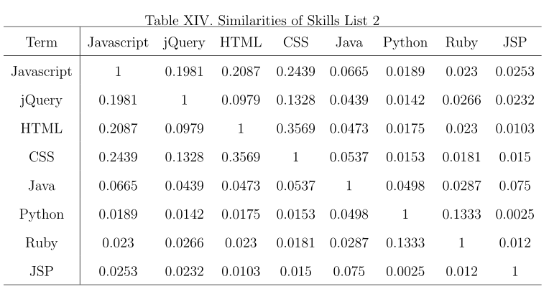
Statistical-based Ontology Similarity Measure

Slide 59
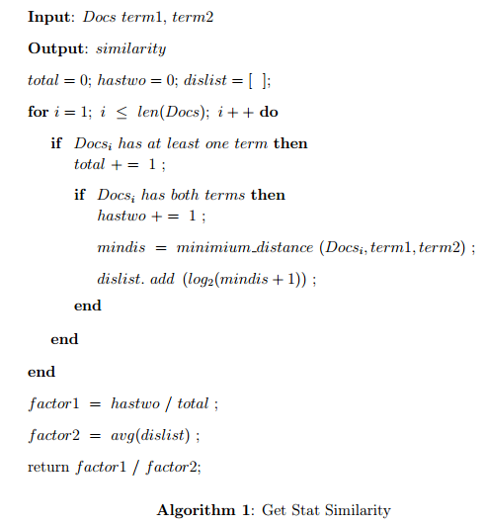
Algorithm of Similarity Calculation

Slide 60
Combine Keyword Search and Résumé Matching
Users’ preference is important
Keyword represents personal preference
Ranking by the similarity values

Slide 61
EVALUATION

Slide 62
EVALUATION – Information Extraction

Slide 63
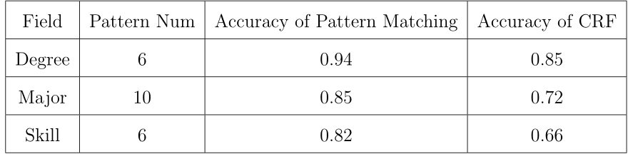
EVALUATION – Information Extraction
Accuracy of Information Extraction Comparing to CRFs Model

Slide 64



EVALUATION – Ontology Similarity
let be the relevance score assessors gave to document for query
NDCG – Normalized Discounted Cumulative Gain
rel_{i} is the relevance score assessors given to document d for query j
Notes:
the graded relevance value is reduced logarithmically proportional to the position of the result.

Slide 65
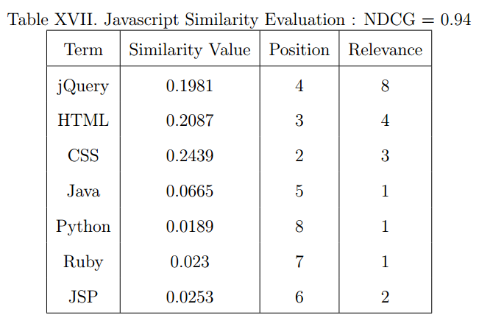
EVALUATION – Ontology Similarity

Slide 66
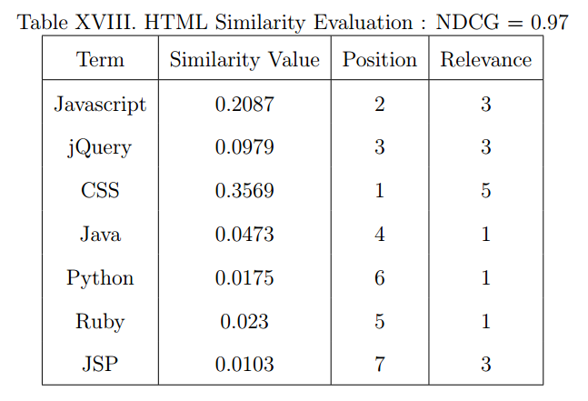
EVALUATION – Ontology Similarity

Slide 67
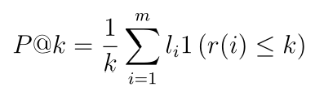
EVALUATION Résumé – Job Matching
NDCG
Precision@K
The proportion of relevant documents in the first K results

Slide 68
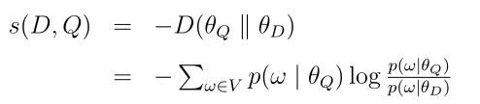
Models to Compare With
KL： Kullback-Leibler divergence
A non-symmetric measure of the difference between two probability distributions of P and Q.
Notes:
In words, it is the expectation of the logarithmic difference between the probabilities P and Q, where the expectation is taken using the probabilities P.

Slide 69

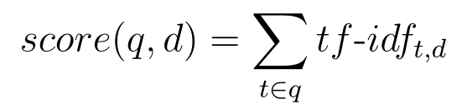
Models to Compare With
TF-IDF：
TF: The term frequency
IDF: The inverse document frequency
Notes:
numerical statistic that is intended to reflect how important a word is to a document in a collection or corpus。

Slide 70
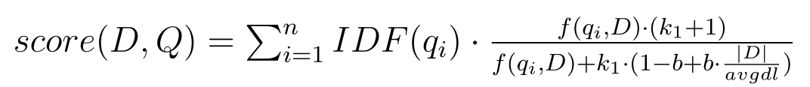
Models to Compare With
Okapi BM25:
A bag-of-words retrieval model that ranks a set of documents based on the query terms appearing in each document
Notes:
Where f(q,D) is 's term frequency in the document D

Slide 71
Experiment Setup
5 résumés
100 jobs in the system
Relevance values between résumés and jobs are manually assigned

Slide 72
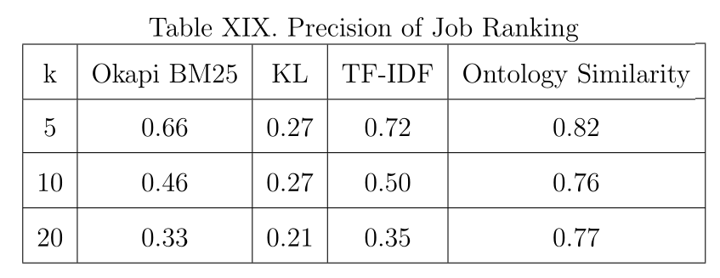
EVALUATION – Ontology Matching

Slide 73
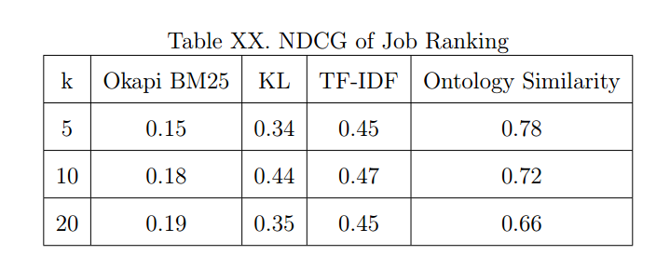
EVALUATION – Ontology Matching

Slide 74
Summary
A finite state transducer based pattern matching tool for information extraction
A semi-automatic approach to collect technical terms
A statistical-based ontology similarity measure
A new searching approach which combines keyword searching and model matching

Slide 75
Future Work
Clustering the résumé and job models to decrease the size of the matching set.
Building more complex job and Résumé model
Using hybrid recommendation techniques

Slide 76
Acknowledgements
Dr. Tracy Hammond (Chair)
Dr. Anxiao Jiang (Committee member)
Dr. Daniel W. Goldberg (Committee member)
Members of Sketch Recognition Lab

Slide 77
Reference
ACM. (2012) Acm computing classication system. [Online]. Available: http://www.acm.org/about/class/2012
A. V. Aho and J. D. Ullman, Foundations of computer science. Computer Science Press New York, 1992, vol. 2.
S. T. Al-Otaibi and M. Ykhlef, \A survey of job recommender systems," International Journal of the Physical Sciences, vol. 7, no. 29, pp. 5127{5142, 2012.
D. E. Appelt and B. Onyshkevych, \The common pattern specication language," in Proceedings of a workshop on held at Baltimore, Maryland: October 13-15, 1998. Association for Computational Linguistics, 1998, pp. 23{30.
S. Bird, \Nltk: the natural language toolkit," in Proceedings of the COLING/ACL on Interactive presentation sessions. Association for Computational Linguistics, 2006, pp. 69 - 72.
C. Bizer, J. Lehmann, G. Kobilarov, S. Auer, C. Becker, R. Cyganiak, and S. Hellmann, \Dbpedia-a crystallization point for the web of data," Web Semantics: science, services and agents on the world wide web, vol. 7, no. 3, pp.154-165, 2009.

Slide 78
Thank you

Slide 79
Ontology similarity
Path-based approaches
They assume that all links in the ontology have uniform distance

Slide 80
Ontology similarity
Feature-based measures
Only big ontologies like Wordnet have this kind of information

Slide 81
Ontology similarity
Content-based measures
LCS -- is the Least Common Subsumer
IC -- IC is Information Content
The concepts must enough common subsumers.
Notes:
IC negative logarithmic value of its probability of occurrence

